Slide 1
Operating Systems 2
Processes

Slide 2
Introduction
What is a process….
The process scheduler
The process control Block; elements of the PCB
Creating process in Unix/Linux
fork() command
Wait() command
exec commands
Multiprocessing system: scheduling; interprocess communication (synchronisation, asynchronous)

Slide 3
Some revision
Simple system
Single user
One processor: busy only when executing the user’s job or system software
Multiprogramming environment: multiple processes competing to be run by a single CPU
Requires fair and efficient CPU allocation for each job

Slide 4
Definitions
Processor (CPU)
Performs calculations and executes programs
Program (job)
Inactive unit, e.g., “an application stored on a secondary storage disk”
Unit of work submitted by the user
Process (task)
A single instance of an executable program
Active entity that Requires resources (such as processor, special registers, its own memory space, and context data or process control box (PCB) ) to perform its function

Slide 5
Definitions (cont’d.)
Thread (of control)
Portion of a process; a process can have multiple threads of control
A process is equivalent to a program while threads are equivalent to modules/methods within the program
A thread is executed “independently” within the parent process;

Slide 6
Definitions
Multiprogramming
Processor allocated to each job/process/thread for a time period
E.g. two or more programs (jobs). The jobs are independent of one another.
Executing job 1 and job 2 is in a queue. At an appropriate time (i/o instruction) an interrupt is evoked; and the position of execution is noted: the register contents including the program counter are updated.
Then job 2 is executed and either at an interrupt or when finished job 1 begins from point where it stopped executing
In a single processor the jobs are interleaved (run concurrently)
In multiprocessor system can be run in parallel

Slide 7
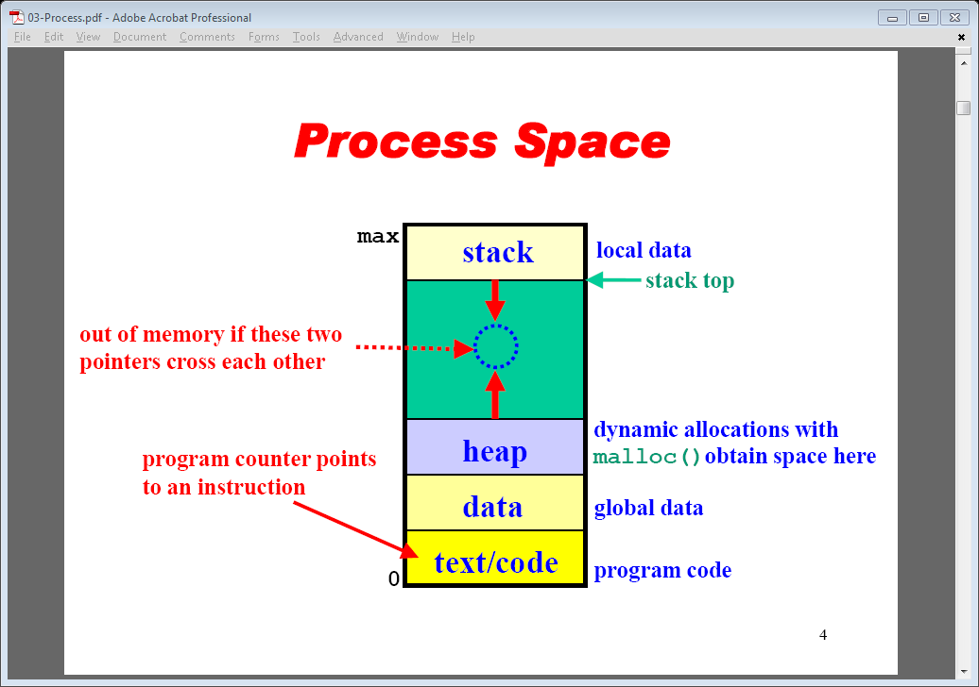
Process Space

Slide 8
Scheduling Submanagers (cont'd.)
Job Scheduler functions
Selects incoming job from queue
Places in process queue
Decides on job initiation criteria
Process scheduling algorithm and priority (priority queues)
Goal
Sequence jobs
Efficient system resource utilization
Balance I/O interaction and computation
Keep most system components busy most of time

Slide 9
Process Scheduler
Process Scheduler functions
Determines process to get CPU resource
When and how long
Decides interrupt processing
Determines queues for process movement during execution
Recognizes job conclusion
Determines process termination
Lower-level scheduler in the hierarchy
Assigns CPU to execute individual actions: jobs placed on READY queue by the Job Scheduler

Slide 10
Process Scheduler (cont'd.)
Exploits common computer program traits
Programs alternate between two cycles
CPU
I/O cycles
General tendencies
I/O-bound job
Many brief CPU cycles and long I/O cycles (printing documents)
CPU-bound job
Many long CPU cycles and shorter I/O cycles ( a complex maths calculation)

Slide 11
Job and Process States
Status changes: as a job or process moves through the system
HOLD and placed in a queue (sometimes a priority queue
READY (job begins processing if enough resources available)
WAITING (can not continue until specific resource available e.g. i/o request
RUNNING: processing
FINISHED

Slide 12
Process Management
The entire state of the process at any instant is contained in its context (process control block)
Notes:
Figure 2.8 indicates a way in which processes may be managed. Two processes,
A and B, exist in portions of main memory. That is, a block of memory is
allocated to each process that contains the program, data, and context information.
Each process is recorded in a process list built and maintained by the OS. The
process list contains one entry for each process, which includes a pointer to the
location of the block of memory that contains the process. The entry may also
include part or all of the execution context of the process. The remainder of the
execution context is stored elsewhere, perhaps with the process itself (as indicated
in Figure 2.8 ) or frequently in a separate region of memory. The process index
register contains the index into the process list of the process currently controlling
the processor. The program counter points to the next instruction in that process
to be executed. The base and limit registers define the region in memory occupied
by the process: The base register is the starting address of the region of memory
and the limit is the size of the region (in bytes or words). The program counter and
all data references are interpreted relative to the base register and must not exceed
the value in the limit register. This prevents interprocess interference.
In Figure 2.8 , the process index register indicates that process B is executing.
Process A was previously executing but has been temporarily interrupted. The
contents of all the registers at the moment of A’s interruption were recorded in its
execution context. Later, the OS can perform a process switch and resume execution
of process A. The process switch consists of storing the context of B and restoring
the context of A. When the program counter is loaded with a value pointing into A’s
program area, process A will automatically resume execution.

Slide 13
Fields of a process control block (PCB)
Process id. A unique number assigned when job enters the system
Process status: hold, ready, running waiting
Process state (all information to indicate current state of the job
Program counter: current instruction counter
register contents; e.g. accumulator register
Main memory: where the job is stored by refer to process management table (P.M.T.)
Resources: hardware (disk) or files
Priority: determines when the job will run
Accounting: what resources, e.g. CPU, the job used and for how long

Slide 14
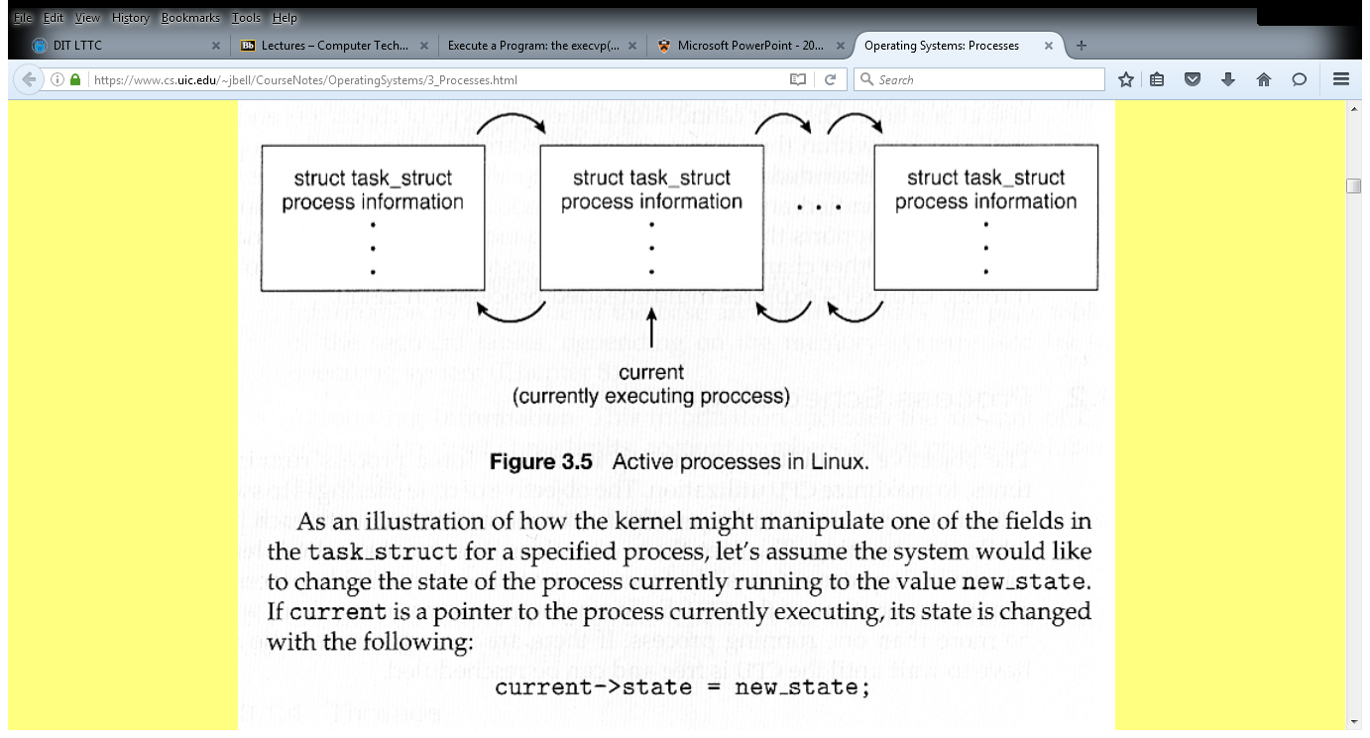
Managing process List (URL double link list link)rocess list
Task_struct is linux implementation of the PCB

Slide 15
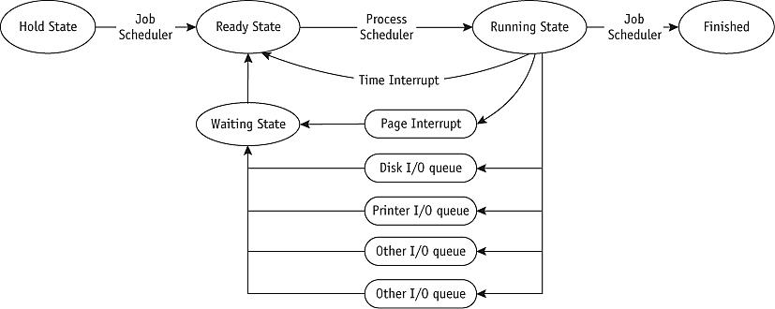
Processing states (Control Block) and Queuing (cont'd.)
(figure 4.5)
Queuing paths from HOLD to FINISHED. The Job and Processor schedulers release the resources when the job leaves the RUNNING state.

Slide 16
Scheduling Policies
Multiprogramming environment
More jobs than resources at any given time
Operating system pre-scheduling task
Resolve three system limitations
Finite number of resources (disk drives, printers, tape drives)
Some resources cannot be shared (mutual exclusion) once allocated (printers)
Some resources require operator intervention before reassigning: mouse click / keyboard…

Slide 17
Scheduling Policies (cont'd.)
Good process scheduling policy criteria (cont'd.)
Maximize CPU efficiency
Keep CPU busy 100 percent of time
Ensure fairness for all jobs
Give every job equal CPU and I/O time
Final policy criteria decision lies with system designer or administrator (select a scheduling policy that maximises efficiency of system resources)

Slide 18
Scheduling Policies (cont'd.)
Problem
Job claims CPU for very long time before I/O request issued
Builds up READY queue and empties I/O queues
Creates unacceptable system imbalance
Corrective measure
Interrupt
Used by Process Scheduler upon predetermined expiration of time slice
Current job activity suspended
Reschedules job into READY queue

Slide 19
Scheduling Policies (cont'd.)
Types of scheduling policies (will be referred to in process scheduling lecture)
Preemptive
Used in time-sharing environments
Interrupts job processing after a specific amount of time if there has been no other interrupts
Transfers CPU to another job (round robin)
Non-preemptive
Functions without “external” interrupts
a job or process remains in a running state until interrupted by internal interrupts e.g. I/O request: used in batch systems

Slide 20
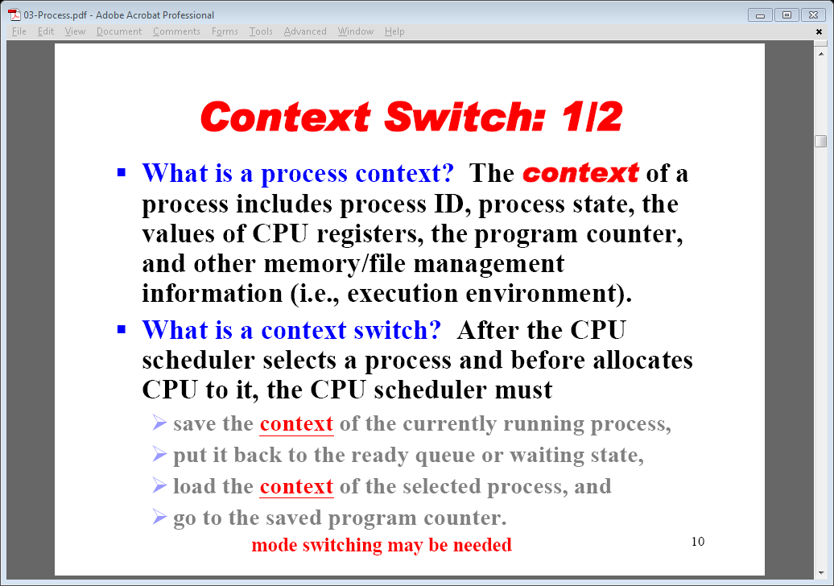
Re-scheduling a process

Slide 21
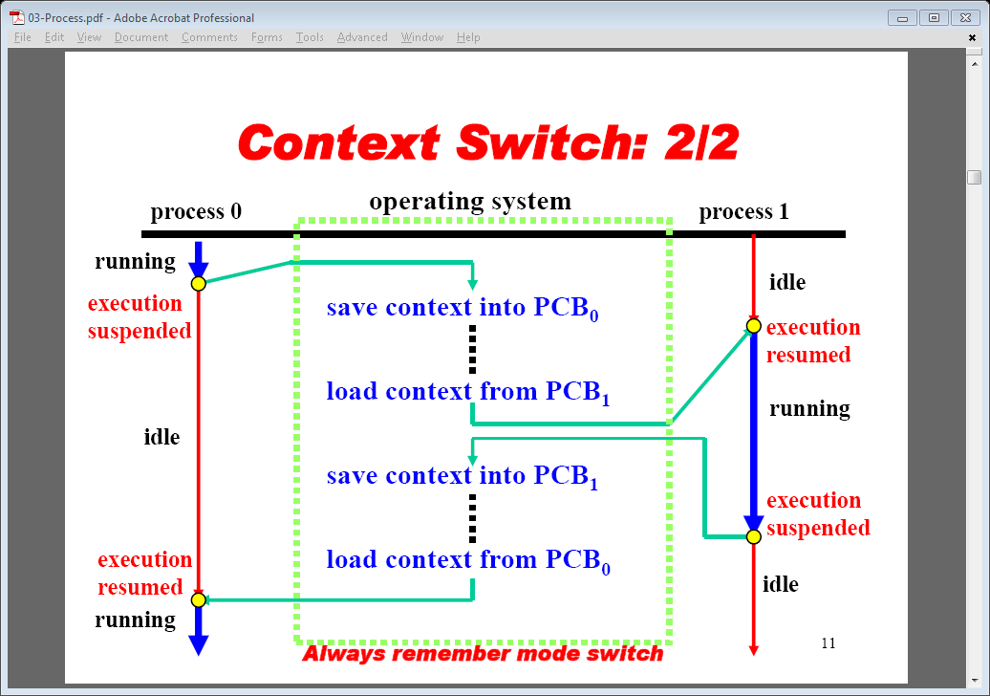
Illustration of context switching

Slide 22
Lists/Queues and content switching
Process management is a combination of different Queues (enqueue/dequeue/ headPtr/TailPtr for each…)
Ready Queue: enqueue/dequeue: Node contains a process ID…
On Context switching the PCB structure is update on the last (edit contents).
The process ID is dequeued from head ready queue.
Used to find corresponding PCB node (currentPtr moved to node)
PCB (context) Data written from node to registers
The call stack register is updated to process call stack
The program counter register is updated for new process
The other queues continue to enqueue as appropriate
Scheduling polices that result in priority queues

Slide 23
Executing a program in linux:
The following shots that the bash is an active process (note ps command show active processes)
The ls command (program is shown at the prompt before execution: the bash is currently the only active process. running
On pressing return 3 things are happening:
The bash command code is copied to a different location (different PID): the processes is forked
The parent process (bash) is forced to stop executing (Wait)
The ls code over writes the copied bash code and executes: this displays all files and directories
When it is finished the bash/prompt of parent process is reactivated (continues with execution)

Slide 24
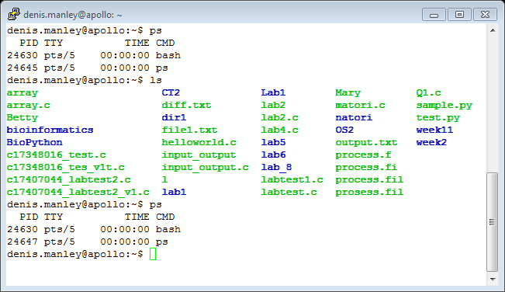
Screen shot of running a process

Slide 25
Sample Questions
Briefly describe the elements of a PCB (4 marks)
Explain the steps a process can undergo as through the job and process scheduler. (8 marks)
Describe the process of context switching as it applies to process control blocks (PCB). (5 marks)
In linux a process is created using the fork() command. Explain the steps that occur if a fork() command is called (8 marks)

Slide 26
Sample Question
The wait () command is another important associated with processes: Explain, using a suitable example, exactly how the wait functions works (10 marks).
The execvp command has the following format:
int execvp(char *prog, char *argv[])
Explain what values are stored in the prog and the argv parameters if the two command line argument are: gcc and file1.c (4 marks)
Explain how the following code using a combination of the fork(), wait() and exec() command can be used to run new processes. (12 marks)

Slide 27
Sample Question
if ((pid = fork()) < 0) { /* fork a child process */
printf("*** ERROR: forking child process failed\n");
exit(42);
}
else if (pid == 0) { /* for the child process: */
if (execvp(*argv, argv) < 0) { /* execute the command */
printf("*** ERROR: exec failed\n");
exit(1);
}
}
else { /* for the parent: */
while (wait(&status) != pid) /* wait for completion */
;
}

